Slide 1
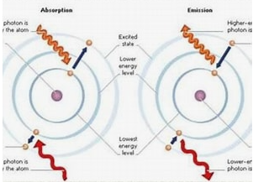
LASER Principle
Based on stimulated emission
When an excited atom is hit
by a photon of the same energy,
it emits an additional identical photon
This leads to amplification of light

Slide 2
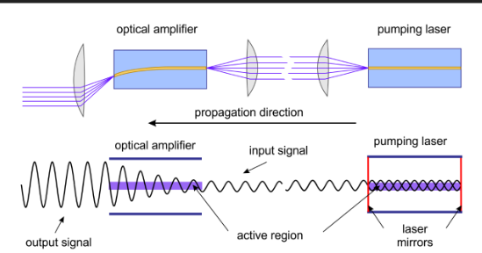
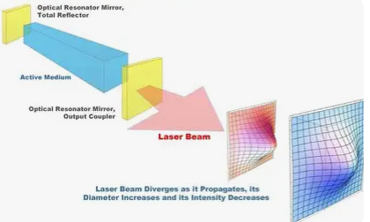
Fundamental Components
Active medium – solid, liquid, or gas (produces laser light)
Energy source (pumping) – excites atoms (electrical, optical, chemical)
Optical resonator (mirrors) – reflects light back and forth to amplify it

Slide 3
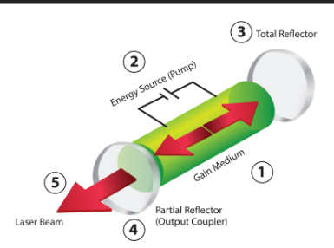
Active Medium
The active medium is the material that produces laser light.
It can be a solid (e.g., Ruby, Nd: YAG)
Liquid (e.g., dye lasers)
Gas (e.g., He–Ne, CO₂ lasers)

Slide 4
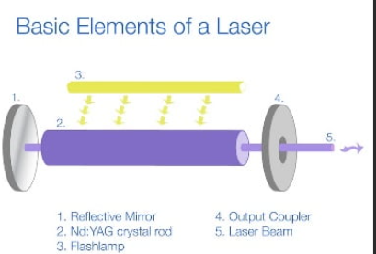
Role
Atoms or molecules in the active medium get excited
When they return to a lower energy level, they emit photons
These photons are amplified to produce laser radiation

Slide 5
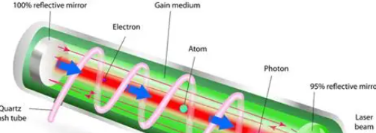
Energy Source (Pumping)
The energy source, also called pumping, provides energy to the active medium.
Purpose:
To excite atoms from lower energy levels to higher energy levels
To create population inversion, which is necessary for laser action

Slide 6
Types of Pumping
Electrical pumping – electric current or discharge (gas lasers)
Optical pumping – light source like flash lamps (solid-state lasers)
Chemical pumping – energy from chemical reactions

Slide 7
Optical Resonator (Mirrors)
The optical resonator consists of two mirrors
placed at both ends of the active medium.
One mirror is fully reflecting
The other is partially reflecting

Slide 8
Role
Reflects photons back and forth through the active medium
Causes repeated stimulated emission, increasing light intensity
The partially reflecting mirror allows a portion of light to escape as the laser beam

Slide 9
Population Inversion
More atoms in excited state than ground state
Essential condition for laser action

Slide 10
Laser Radiation
Produced due to stimulated emission
Emitted photons have:
Same wavelength
Same phase, Same direction
Optical cavity amplifies radiation by multiple reflections
A portion exits as the laser beam

Slide 11
Characteristics of Laser Radiation
Monochromatic
Single wavelength or color
Coherent
All waves are in phase (spatial and temporal coherence)
Highly Directional
Very low divergence
Travels long distances without spreading
High Intensity
Energy concentrated in a small area
Polarized
Vibrations occur in one plane

Slide 12
Biological Tissue Composition
Water (60–80%)
Major absorber of infrared laser radiation
Proteins
Collagen, elastin
Provide structure and strength
Lipids
Cell membranes and fat tissues
Absorb certain laser wavelengths
Pigments
Melanin – skin, hair
Hemoglobin – blood
Important for laser absorption
Minerals
Calcium and phosphate (bones, teeth)

Slide 13
Questions
What is meant by an active medium in a laser?
Define pumping in laser operation.
What is the function of an optical resonator in a laser?
What is population inversion and why is it important?
Name any two types of pumping methods used in lasers.

Slide 14
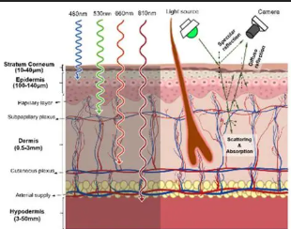
Light Penetration & Reflectance (Laser Medicine)
Part of laser light is reflected at tissue surface
Remaining light penetrates and is absorbed or scattered
Penetration depth depends on wavelength and tissue type

Slide 15
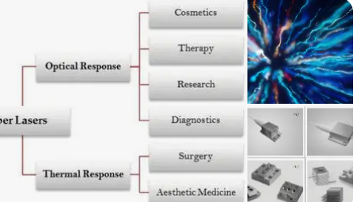
Laser Medicine Domains
Diagnosis (imaging, spectroscopy)
Therapy (surgery, phototherapy, cancer treatment)
Monitoring (blood flow, oxygenation)

Slide 16
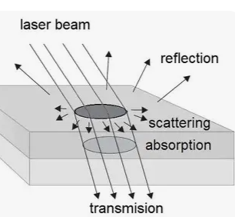
Laser Light Scattering in Tissues
Scattering spreads light inside tissue
Reduces image clarity but increases treated volume
Strongly affects dose distribution and effectiveness

Slide 17
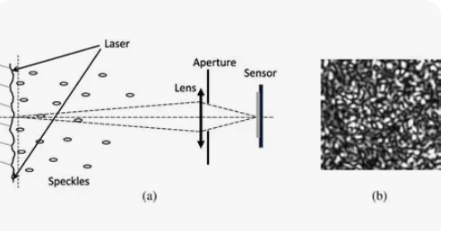
Speckle Formation
Granular pattern from coherent laser light scattered by tissue
Sensitive to tissue motion and structure

Slide 18
Interference Methods
Based on superposition of coherent light waves
Used in OCT and interferometry for high-resolution imaging

Slide 19
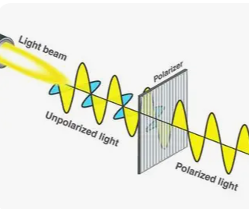
Polarization Methods
Analyze changes in light polarization after tissue interaction
Reveal tissue structure, and pathological changes

Slide 20
Questions
What causes speckle formation when laser light interacts with biological tissue?
How does tissue motion affect speckle patterns in optical diagnostics?
What is the basic principle behind interference-based tissue imaging methods?
Why is Optical Coherence Tomography (OCT) able to achieve high spatial resolution?
How do polarization-based methods help in identifying structural or pathological changes in tissues?

Slide 21
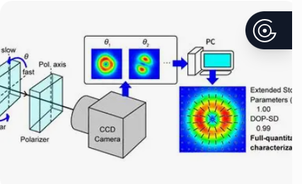
Interference and polarization methods of tissue diagnostics
Interference-based methods
These techniques rely on coherent light interference
to extract depth-resolved or structural
information from tissue.

Slide 22
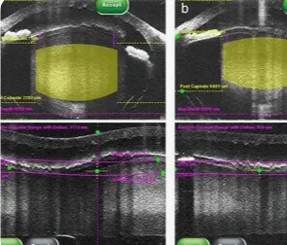
Optical Coherence Tomography (OCT)
Uses low-coherence interferometry
Provides micrometer-scale, cross-sectional images
Sensitive to refractive index changes and scattering
Applications: ophthalmology, dermatology, oncology

Slide 23
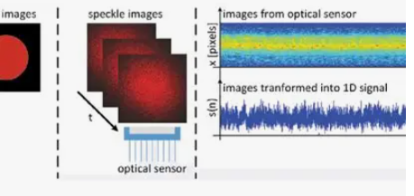
Speckle interferometry
Analyzes speckle pattern changes due to motion or deformation
Used for blood flow and tissue dynamics

Slide 24
Diagnostic value
Detects microstructural changes that occur
before macroscopic pathology appears.

Slide 25
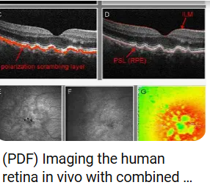
Polarization-based methods
Polarization-sensitive OCT (PS-OCT)
Measures birefringence and depolarization
Sensitive to collagen, muscle fibers, and myelin
Mueller matrix polarimetry
Quantifies tissue scattering, absorption, and anisotropy
Differentiates healthy vs pathological tissue

Slide 26
Diagnostic value
Early detection of fibrosis, cancer, and structural degeneration via collagen remodeling.

Slide 27
Alterations of biotissue properties during hyperthermal and ablation reactions
Hypern-thermal effects (≈ 40–60 °C)
Protein denaturation
Increased membrane permeability
Changes in refractive index and scattering coefficient
Altered blood perfusion and oxygenation

Slide 28
Optical consequences
Increased light scattering
Reduced birefringence due to collagen denaturation

Slide 29
Thermal ablation (> 60 °C)
Coagulative necrosis
Cell membrane rupture
Carbonization and vaporization at very high temperatures

Slide 30
Optical property change
Strong absorption increase
Loss of tissue anisotropy
Irreversible structural damage
Clinical relevance:
Real-time optical monitoring improves
ablation precision and safety

Slide 31
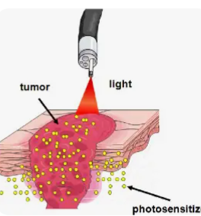
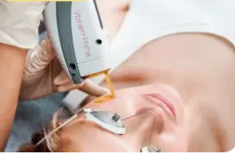
Photodynamic therapy (PDT)
Principle
PDT combines:
Photosensitizer
Light of specific wavelength
Oxygen
This generates reactive oxygen species (ROS) that induce cell death

Slide 32
Photodynamic therapy (PDT)
PDT combines:
Photosensitizer
Light of specific wavelength
Oxygen
This generates reactive oxygen species (ROS) that induce cell death. PDT combines:
Photosensitizer
Light of specific wavelength
Oxygen
This generates reactive oxygen species (ROS) that induce cell death.

Slide 33
Mechanisms of action
Direct tumor cell destruction
Damage to tumor vasculature
Activation of immune response

Slide 34
Advantages
High spatial selectivity
Minimal damage to surrounding healthy tissue
Can be combined with optical diagnostics (theranostics)

Slide 35
Optical diagnostics in PDT
Fluorescence monitoring of photosensitizer uptake
Oxygen saturation measurements
Polarization changes indicating tissue response
`

Slide 36
Questions
What physical principle is used in interference-based tissue diagnostics such as OCT?
How does tissue birefringence change during thermal denaturation?
Which optical properties of bio tissue are altered during thermal ablation?
What are the three essential components required for photodynamic therapy?
Why are polarization methods useful for detecting early pathological changes in tissue?

Slide 37
Solid-State Lasers
Solid-state lasers use a solid crystalline or glass
host material doped with active ions as the gain medium.
The laser action occurs due to electronic transitions
of dopant ions embedded in the crystal lattice.

Slide 38
Example
Ruby laser
Nd:YAG laser

Slide 39
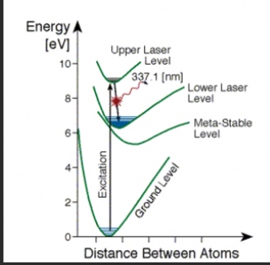
ENERGY LEVEL
Ruby Laser (Three-Level Laser)
Ground state → Pump level → Metastable level → Ground state
Requires high pumping power
Operates in pulsed mode

Slide 40
Construction
Active medium: Solid crystal or glass doped with ions
Ruby laser → Al₂O₃ doped with Cr³⁺

Slide 41
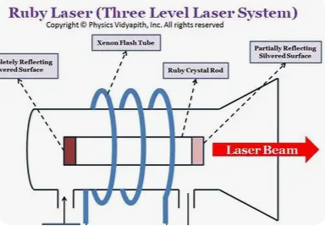
Ruby Laser
Host material: Aluminum oxide (Al₂O₃)
Dopant ion: Chromium (Cr³⁺) ions (~0.05%)
Cr³⁺ ions replace Al³⁺ ions in the crystal lattice
Responsible for laser emission at 694.3 nm (red light)

Slide 42
Pumping source
Pumping source: Flash lamp or laser diode
Optical resonator: Two mirrors (one fully reflecting, one partially reflecting)

Slide 43
Working Principle
Pumping excites atoms to higher energy levels.
Atoms undergo non-radiative decay to a metastable state.
Population inversion is achieved.
Stimulated emission produces coherent light.
Light oscillates between mirrors and exits through the partially reflecting mirror.

Slide 44
Nd:YAG laser (Four-Level Laser)
Lower laser level is above ground state
Easier population inversion
Can operate in continuous mode

Slide 45
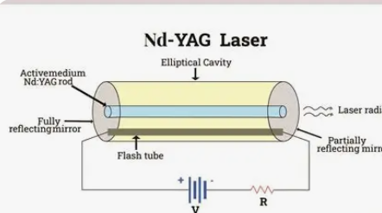
Construction
Nd:YAG → Yttrium Aluminum Garnet doped with Nd³⁺

Slide 46
ADVANTAGES OF SOLID-STATE LASERS
High output power
Compact and robust
Long operational life
Good beam quality

Slide 47
APPLICATIONS
Material processing
Medical surgery
Range finding
Communication systems
Scientific research

Slide 48
Questions
What is solid state LASER?
Define the basic principle behind solid state Laser?
Differentiate between Ruby laser &Nd: YAG laser?
Write the applications and advantages of solid state laser?

Slide 49
GAS LASERS
uses a gas or mixture of gases as the active medium. Excitation of gas atoms or molecules is achieved by electrical discharge.
Examples: He–Ne laser, CO₂ laser, Argon ion laser

Slide 50
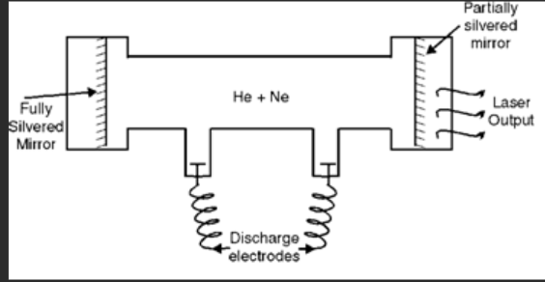
Construction of a Gas Laser (He–Ne Laser
main parts:
(a) Discharge Tube
A long narrow glass capillary tube
Filled with a mixture of Helium (He) and Neon (Ne) gases
Typical pressure:
Helium: ~1 mm Hg
Neon: ~0.1 mm Hg

Slide 51
Electrodes
Two electrodes (anode and cathode)
placed at the ends of the tube
Connected to a high-voltage DC power supply
Used to produce electrical discharge

Slide 52
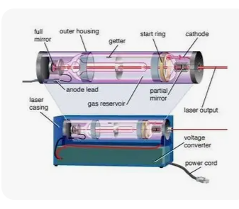
Optical Resonator & Power supply
Two mirrors placed at both ends of the tube:
One fully reflecting mirror
One partially reflecting mirror
Mirrors are aligned along the axis of the tube

Slide 53
Provides high voltage (≈ 1000–3000 V)
Maintains continuous electrical discharge

Slide 54
Energy Level
Helium atoms have metastable energy levels
Neon atoms have energy levels
very close to helium metastable levels
Energy transfer occurs through atomic collisions

Slide 55
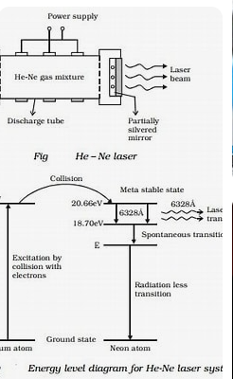
Working Principle of Gas Laser (He–Ne Laser)
Electrical discharge
Population inversion
Stimulated emission

Slide 56
Electrical Discharge
High voltage is applied across the electrodes
Electrons collide with helium atoms
Helium atoms are excited to metastable states

Slide 57
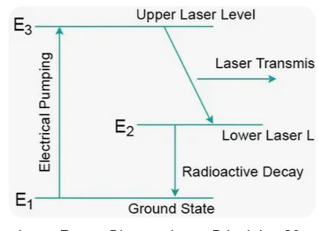
Energy Transfer by Collision
Excited helium atoms collide with neon atoms
Energy is transferred from helium to neon atoms
Neon atoms are excited to higher energy states
This process is called resonant energy transfer

Slide 58
Population Inversion
Upper laser levels of neon become more populated
Lower levels quickly decay
Hence, population inversion is achieved in neon atoms

Slide 59
Stimulated Emission
A photon stimulates excited neon atoms
Identical photons are emitted
Light is amplified by multiple reflections between mirrors

Slide 60
Laser Output
Coherent laser beam of wavelength 632.8 nm (red light) emerges through the partially reflecting mirror

Slide 61
Characteristics of Gas Lasers
Highly monochromatic
Highly coherent
Very stable output
Continuous wave (CW) operation possible

Slide 62
Applications of Gas Lasers
He–Ne Laser
Holography
Optical alignment
Interferometry
Barcode scanners
Educational and research labs

Slide 63
Questions
What is a gas laser?
Name the active medium used in a He–Ne laser.
Why is helium mixed with neon in a He–Ne laser?
What is meant by population inversion in gas lasers?
State the wavelength of the laser light emitted by a He–Ne laser.

Slide 64
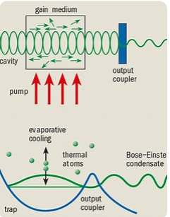
Atomic laser
An atom laser is based on matter-wave coherence:
Every particle with momentum behaves like a wave.

Slide 65
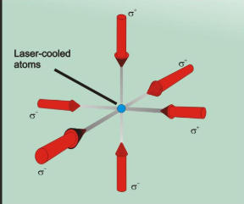
Atom laser, atoms are prepared so that:
They share the same quantum state
They have identical phase
They propagate as a coherent beam

Slide 66
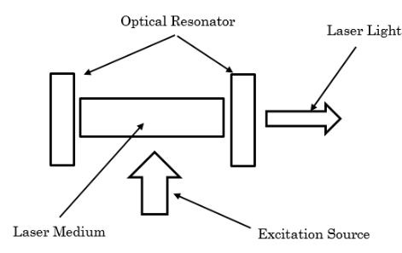
Construction of an Atom Laser
Main Components
(A) Vacuum System
Ultra-high vacuum chamber (~10⁻¹¹ mbar)
Prevents atom collisions with air
Typically stainless steel or glass cell

Slide 67
Atom Source
Alkali atoms commonly used:
Rubidium-87
Sodium-23
Lithium-7
Chosen because they are easy to laser-cool

Slide 68
(C) Laser Cooling System
Uses Doppler cooling and optical molasses:
6 counter-propagating laser beams
Tuned slightly below atomic resonance
Atoms slow down due to photon momentum transfer
Result:
Temperature drops to microkelvin (µK) range

Slide 69
(D) Magneto-Optical Trap (MOT)
Combines:
Laser cooling
Magnetic field gradient
Traps atoms at the center
Increases atomic density

Slide 70
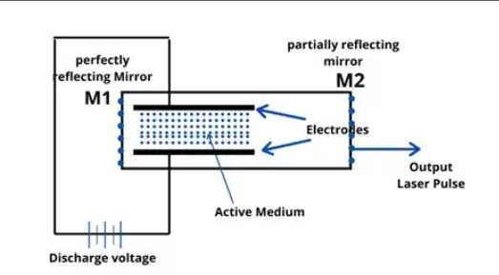
Working
Atoms are cooled to extremely low temperatures (near absolute zero).
They form a Bose–Einstein condensate (BEC), where many atoms occupy the same quantum state.
Atoms are then out-coupled from the condensate in a controlled way, forming a narrow, coherent atomic beam.

Slide 71
Types of Atom Lasers
Pulsed Atom Laser
Atoms released in bursts
Simpler experimentally
Limited coherence time
Analogy: Camera flash

Slide 72
Continuous Atom Laser (CW Atom Laser)
Continuous extraction of atoms
Technically very challenging
Analogy: Continuous-wave optical laser

Slide 73
Gravity-Driven Atom Laser
Atoms propagate along:
Magnetic guides
Optical waveguides
Less beam spreading

Slide 74
Raman Atom Laser
Uses Raman transitions
Highly directional
Precise momentum control
Best for precision measurements

Slide 75
APPLICATIONS
Magnetoencephalography (MEG) & Brain Imaging
Cardiac Diagnostics
MRI Enhancement

Slide 76
Questions
What are atomic laser?
Explain the construction of atomic laser?
What are different types of atomic laser?
Discuss the working of atomic laser

Slide 77
Questions
Explain the thermal and non-thermal effects of laser irradiation on biological tissues.
Discuss the applications of lasers in medicine with special emphasis on photodynamic therapy
Discuss laser light propagation in biological tissues. Explain the mechanisms of absorption, scattering, reflection, and refraction.
Describe stimulated emission, population inversion, and optical resonators. Discuss the characteristics of laser radiation such as coherence, monochromaticity, directionality, and intensity, and explain why these properties make lasers suitable for medical and biological applications.

Slide 78
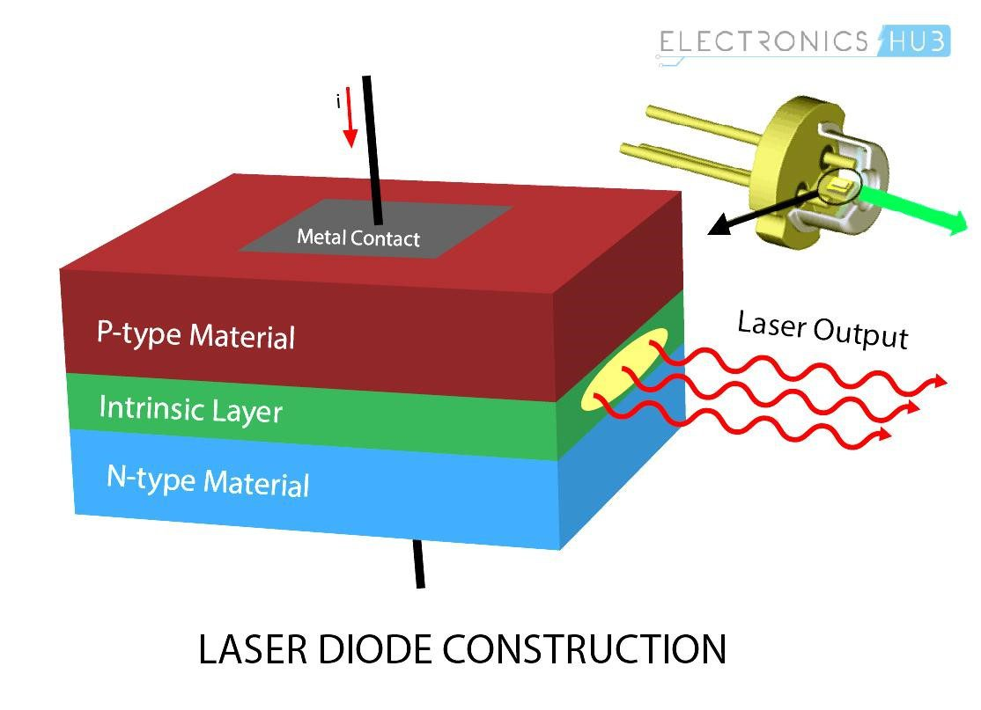
Diode laser
laser that generates light using a semiconductor diode
(similar to an LED, but designed to produce coherent laser light)
It converts electrical energy → laser light
Small, efficient, and widely used
emits light at a specific wavelength

Slide 79
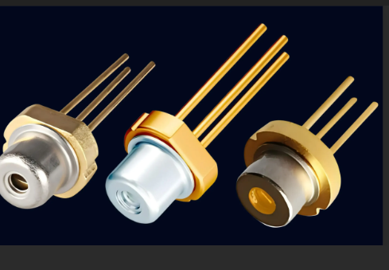
wavelengths
650–680 nm → red (laser pointers, DVD players)
780–850 nm → near-infrared (CD players, sensors)
808–980 nm → industrial, medical, pumping other lasers
1310 & 1550 nm → fiber-optic communications

Slide 80
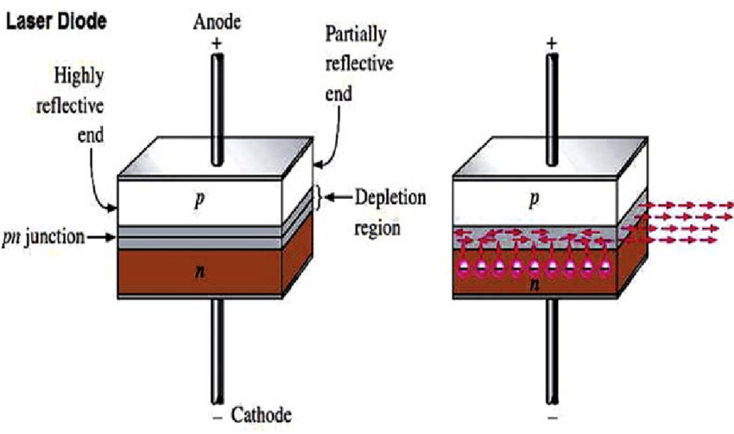
Structure of a Diode Laser
Semiconductor Materials
Common materials include:
GaAs (Gallium Arsenide)
AlGaAs
InGaAs
InGaAsP
These materials determine the wavelength of the laser.

Slide 81
P–N Junction
P-type layer: rich in holes
N-type layer: rich in electrons
When forward biased, electrons and holes recombine in the active region
Active Region
Thin layer where stimulated emission occurs
Designed as a quantum well for better efficiency

Slide 82
Optical Cavity (Resonator)
Two parallel reflective facets at the ends of the chip
One facet is fully reflective
The other is partially reflective (allows laser output)
This cavity provides optical feedback for laser action.

Slide 83
Working Principle
Step 1: Forward Biasing
Apply voltage across the diode
Electrons move from n-side to p-side
Holes move from p-side to n-side
Step 2: Population Inversion
Carrier concentration in the active region increases
More electrons are in excited states than ground states

Slide 84
Step 4: Stimulated Emission
Photons trigger other excited electrons to emit identical photons
Same wavelength, phase, and direction
Step 5: Optical Amplification
Photons bounce between the mirrors
Light intensity builds up
Step 6: Laser Output
A portion of light exits through the partially reflective mirror as a laser beam

Slide 85
4. Threshold Current
The minimum current required to start lasing is called the threshold current
Below this → device acts like an LED
Above this → laser emission begins
This is a critical parameter in diode laser design.

Slide 86
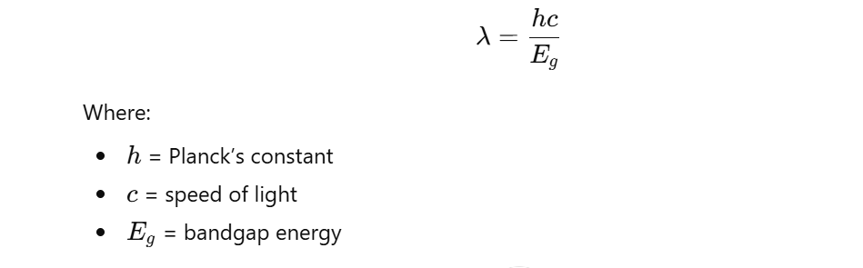
Wavelength Control
The emitted wavelength depends on:
Band gap energy of the semiconductor
Temperature
Current
Approximate relation:

Slide 87
Questions
Explain the construction, working principle, and medical applications of the following lasers:
Solid state laser
Atomic laser
Diode laser
Solid state dye laser
2. Describe the composition of biological tissues and explain the interaction of laser light with tissues. .

Slide 88
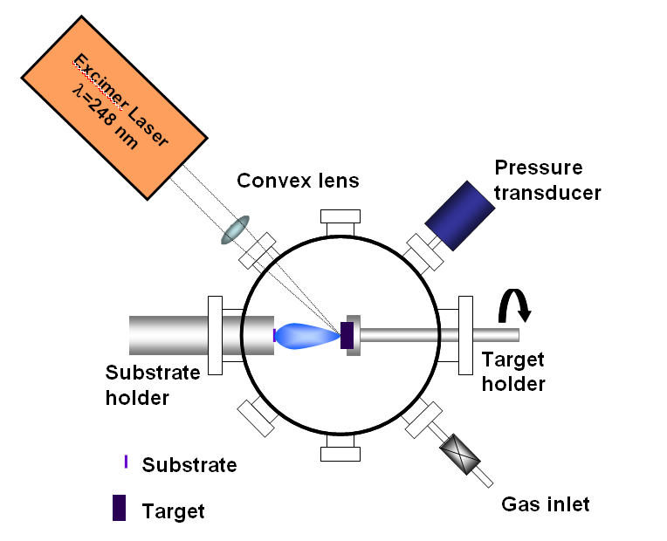
Molecular Laser
molecular laser is a type of laser in which the active (lasing)
medium consists of molecules,
rather than isolated atoms, ions, or semiconductors.

Slide 89
Energy levels: Molecules have vibrational and rotational energy levels
Typical wavelengths: Most molecular lasers operate in the infrared (IR),
though some work in the visible or ultraviolet.
Richer spectra: Because molecules have many closely spaced energy levels,
molecular lasers can produce many discrete .

Slide 90
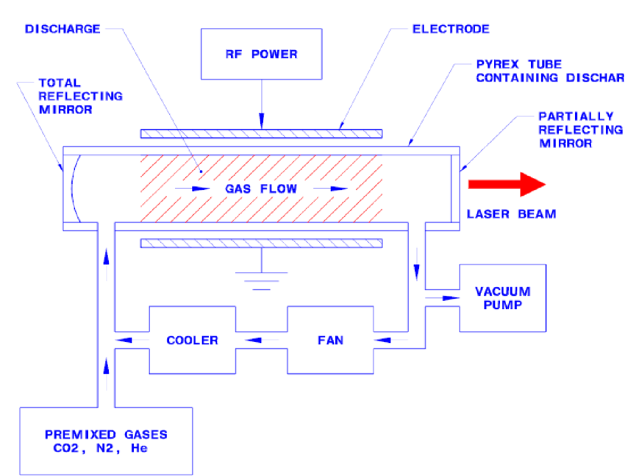
working
Molecules are excited (by an electric discharge, chemical reaction, or optical pumping).
A population inversion is created between two molecular energy states.
Stimulated emission amplifies light at a specific wavelength.

Slide 91
Example
CO₂ laser – very powerful, efficient, widely used in cutting, welding, and medical surgery.
CO laser – infrared spectroscopy and research.

Slide 92
Applications
Industrial material processing
Medical procedures
Spectroscopy and atmospheric sensing
Scientific research

Slide 93
Questions
What is a molecular laser?
Which type of energy levels are involved in molecular lasers?
Name one common molecular laser.
In which region of the spectrum do most molecular lasers operate?
What is one application of a molecular laser?

Slide 94
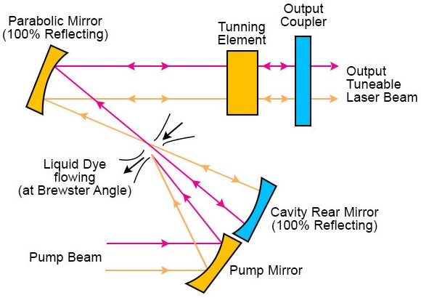
Liquid dye laser
liquid dye laser is a tunable laser
that uses an organic dye dissolved
in a liquid solvent as the active (gain) medium.

Slide 95
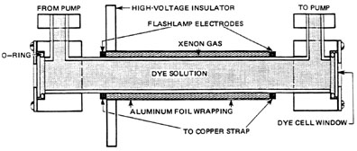
Principle
When optically pumped (usually by a flash lamp or another laser like a Nd: YAG or argon-ion laser), the dye molecules get excited.
Stimulated emission occurs over a wide range of wavelengths.
By inserting a wavelength-selective element (prism or diffraction grating) in the cavity, continuous tuning of the output wavelength is achieved.

Slide 96
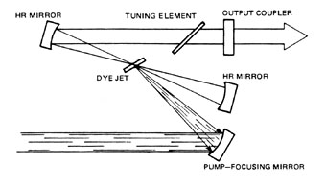
Construction
Gain medium: Organic dye solution (e.g., Rhodamine 6G, Coumarin)
Container: Flowing dye cell (to avoid heating and photodegradation)
Pump source: Flash lamp or laser
Optical resonator: Two mirrors (one partially reflecting)
Tuning element: Prism or diffraction grating

Slide 97
Working
Pump light excites dye molecules to higher energy states.
Rapid non-radiative decay brings them to a metastable excited state.
Stimulated emission produces laser light.
Flowing dye continuously replaces degraded molecules.

Slide 98
Advantages
Very wide tunability (≈ 400–900 nm depending on dye)
High gain
Can produce ultrashort pulses (picoseconds/femtoseconds)

Slide 99
Disadvantages
Dyes degrade over time
Handling of toxic and flammable solvents
More complex maintenance (circulation system)

Slide 100
Applications
Spectroscopy
Medical treatments (dermatology, ophthalmology)
Laser chemistry
Holography
Tunable research lasers

Slide 101
Questions
What is the active medium used in a liquid dye laser?
What is basic principle of liquid laser and construction?
Define the working of liquid laser?
What is the purpose of circulating the dye solution?
Mention the applications of a liquid dye laser.

Slide 102
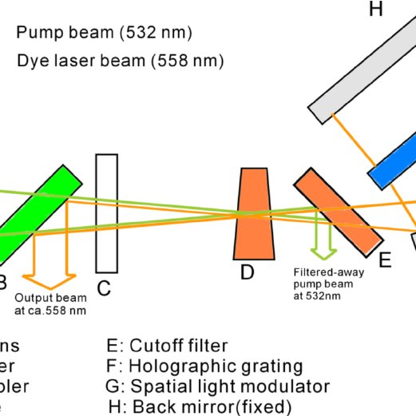
solid-state dye laser
is a type of tunable laser where organic dye
molecules are immobilized in a solid host
instead of being dissolved in a liquid solvent (as in conventional dye lasers).

Slide 103
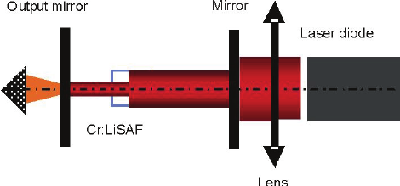
Gain medium: Organic laser dyes (e.g., rhodamine, coumarin)
Host material: Solid matrices such as polymers (PMMA), sol-gel glass, or crystalline hosts
Pumping source: Typically another solid-state laser (e.g., Nd:YAG, frequency-doubled to 532 nm)

Slide 104
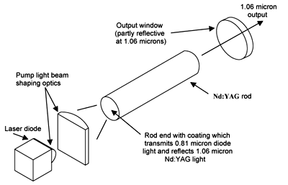
working
The pump laser excites dye molecules embedded in the solid host.
The excited dye molecules undergo stimulated emission.
A laser cavity selects and amplifies a specific wavelength.
By using tuning elements (gratings, prisms), the output wavelength can be adjusted over a broad range.

Slide 105
Advantages
No liquid handling (simpler, cleaner, more robust)
Compact and portable
Broad wavelength tunability (visible to near-IR)
Better mechanical stability than liquid dye lasers

Slide 106
limitations
Photodegradation (bleaching) of dye is faster in solids
Lower lifetime compared to liquid dye systems
Heat dissipation is more challenging in solid hosts

Slide 107
Applications
Spectroscopy
Biomedical imaging
Optical sensing
Research requiring tunable visible light

Slide 108
Questions
Define the laser radiation and its unique characteristics such as coherence, mono chromaticity, directionality, and intensity. Explain how these properties make lasers suitable for medical applications.
Include a detailed explanation of biological tissue composition, mechanisms of light penetration, absorption, reflectance, and scattering in tissues. Discuss factors affecting laser–tissue interaction.
Describe the physical origin of speckle patterns, their characteristics, and their importance in biomedical imaging and tissue diagnostics.
Describe the atomic laser and its types with diagram and label?

Slide 109
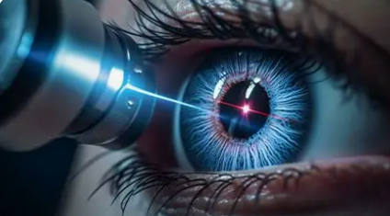
laser in ophthalmology
focused on very small areas
minimal damage to surrounding tissue
non-contact surgery
Can selectively target tissues based on
absorption by pigments (melanin, hemoglobin, water)

Slide 110
Applications
Refractive error correction
Diseases treated:
Myopia
Hypermetropia
Astigmatism

Slide 111
Techniques
LASIK is a laser surgery where a thin flap is made on the cornea, the cornea is reshaped with a laser, and then the flap is put back.
Photorefractive Keratectomy: laser eye surgery where no flap is made. The outer corneal layer is removed, and the laser reshapes the surface of the cornea.

Slide 112
Small Incision Lenticule Extraction: a newer, minimally invasive laser eye surgery where no flap is made. A small piece of corneal tissue (lenticule) is removed through a tiny incision.

Slide 113
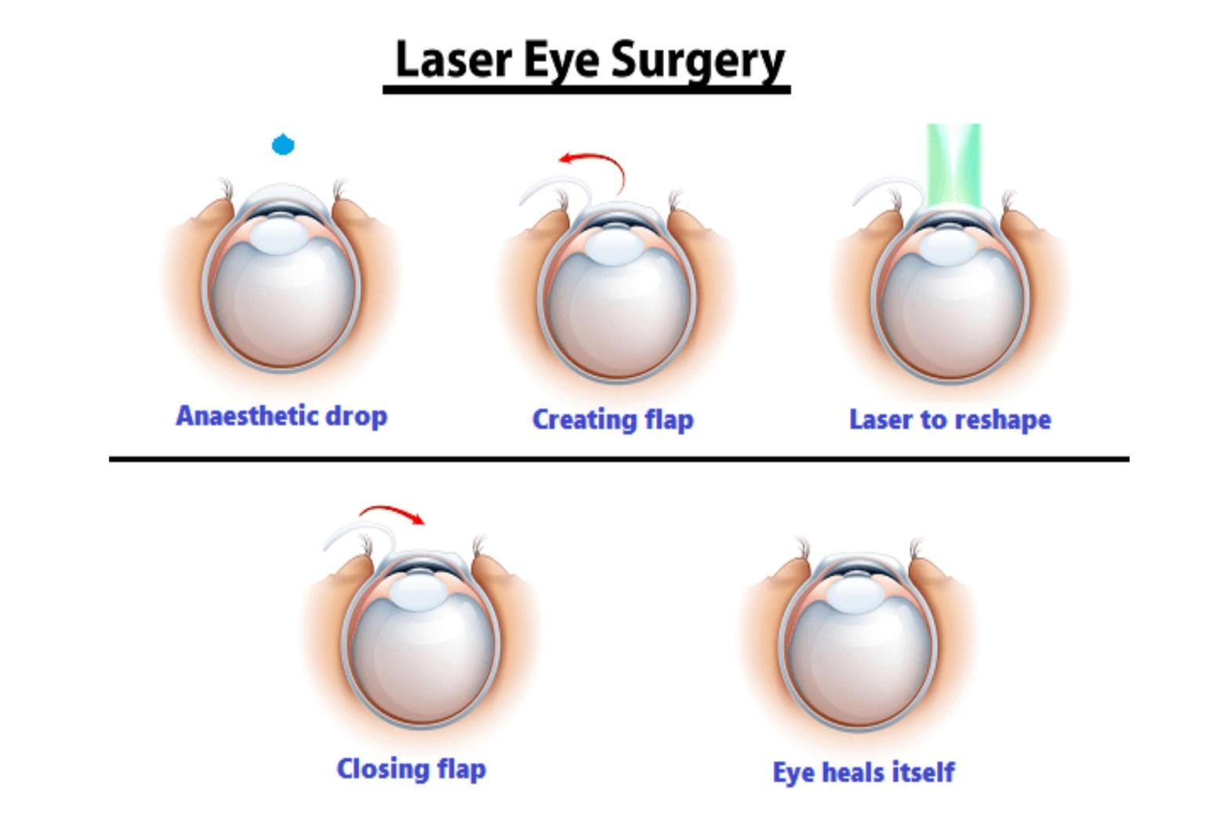
LASIK Procedure
Anesthetic eye drops
A thin corneal flap is created using:
Microkeratome blade or
Femtosecond laser
The flap is lifted gently.
An excimer laser reshapes the inner corneal tissue:

Slide 114
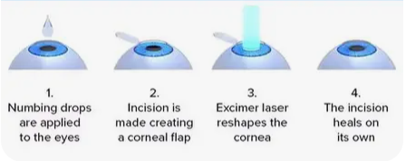
Working
Changes corneal curvature
Allows light rays to focus properly on the retina

Slide 115
Advantages
Very fast vision recovery (1–2 days)
Painless
Minimal discomfort
High success rate

Slide 116
Disadvantages
Flap-related complications possible
Not suitable for thin corneas
Dry eye may occur

Slide 117
Questions
Define the use of laser in ophthalmology?
What are the techniques used in ophthalmology?
Describe the procedures of LASIK & its working principle?
Show the advantages of LASIK?

Slide 118
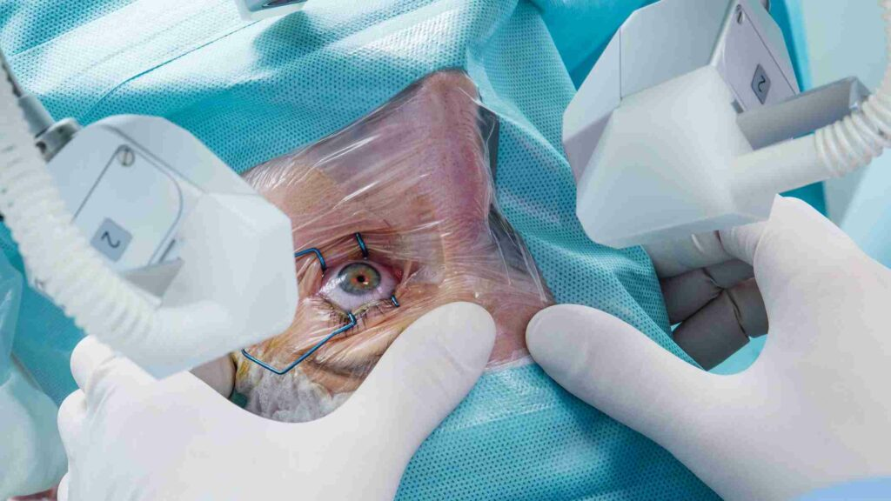
Photorefractive Keratectomy Steps
Eye is numbed with drops.
The epithelium (outer layer) of the cornea is removed.
Excimer laser reshapes the corneal surface.
A soft contact lens is placed as a bandage.
Epithelium regrows in 3–5 days.

Slide 119
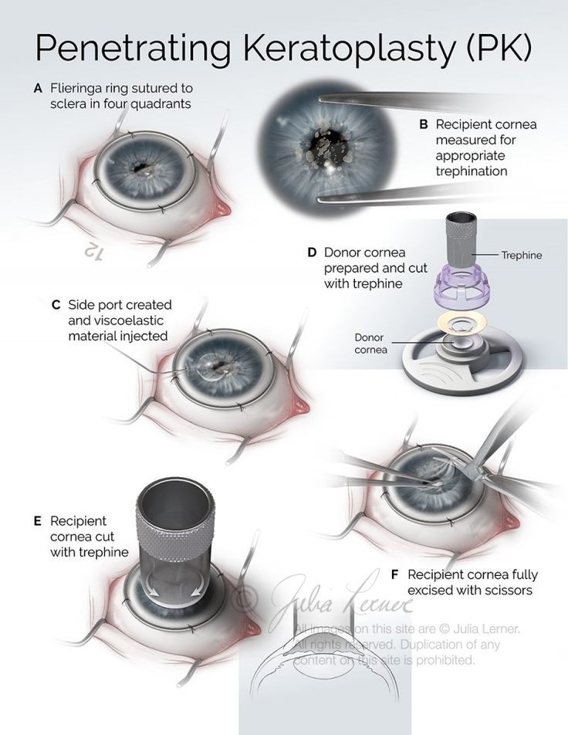
Working
Surface cornea is reshaped
New epithelium grows with corrected shape

Slide 120
Advantages
No flap → safer for thin corneas
Less risk of flap complications
Suitable for people with trauma-prone jobs (army, sports)

Slide 121
Disadvantages
More pain for a few days
Slower visual recovery (1–2 weeks)
Temporary corneal haze may occur

Slide 122
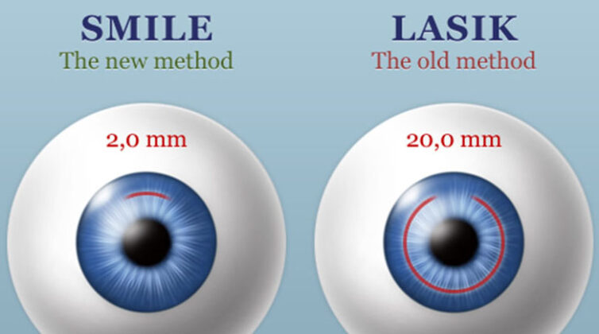
SMILE
Eye is numbed with drops.
Femtosecond laser creates:
A small disc-shaped tissue (lenticule)
A tiny incision (2–4 mm)
Surgeon removes the lenticule through the incision.
Cornea changes shape automatically.

Slide 123
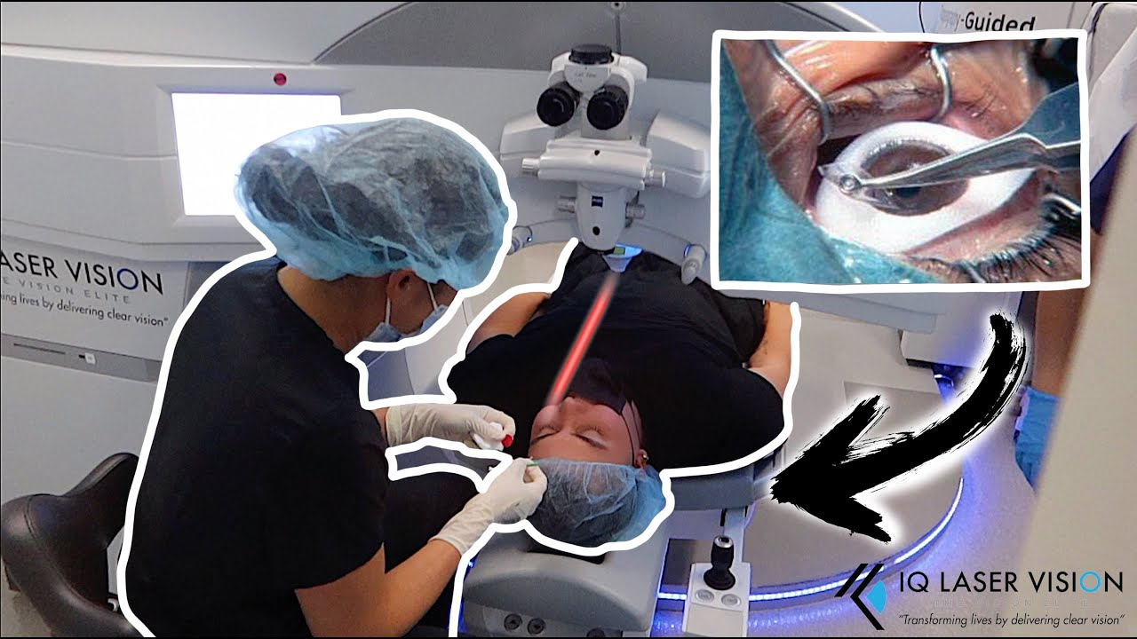
Working
Removing the lenticule reshapes the cornea
Corrects refractive error

Slide 124
Advantages
No flap
Smaller incision
Less dry eye
Stronger cornea after surgery
Quick recovery

Slide 125
Disadvantages
Costly
Limited correction (mainly myopia & astigmatism)
Not suitable for very high hypermetropia

Slide 126
QUESTIONS
Discuss the steps involved in PRK?
Describe the advantages & disadvantages in PRK?
Define smile and working principle?
What are the advantages of smile?

Slide 127
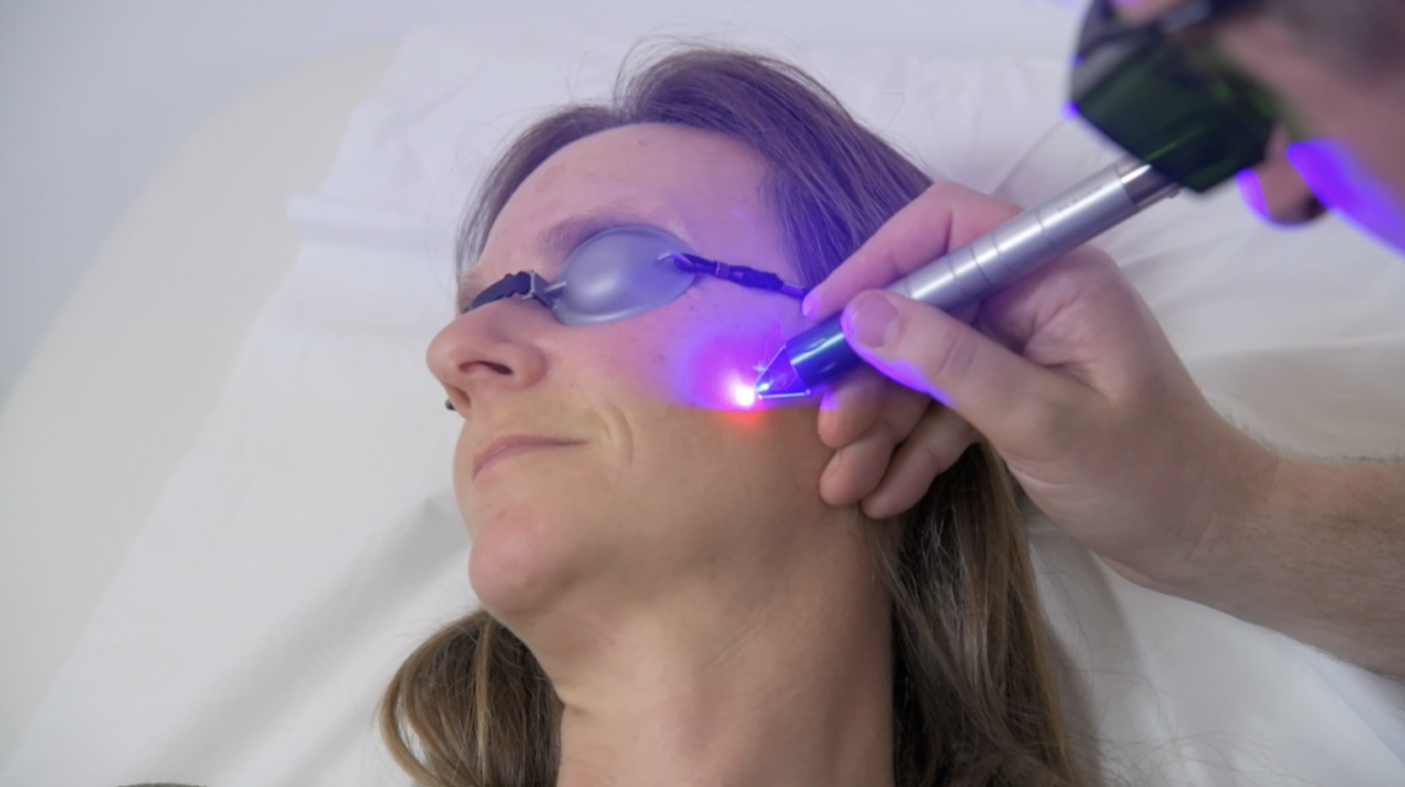
Lasers in Dermatology – Handling of Pain
Pain during laser procedure
depends on the laser type, energy used,
treatment depth, and body site.
Proper pain control improves patient comfort,
cooperation, and treatment outcomes.

Slide 128
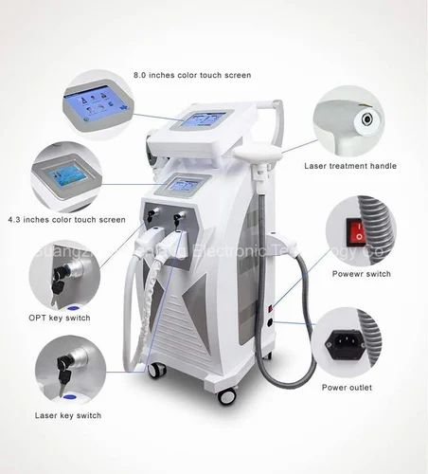
Pre-procedure Measures
Patient counseling: Explain the procedure, expected sensations (warmth), and duration to reduce anxiety.

Slide 129
Topical anesthetics (most commonly used):
Lidocaine
Prilocaine
Eutectic mixtures such as EMLA cream
(lidocaine 2.5% + prilocaine 2.5%).

Slide 130
Applied 30–60 minutes before treatment,
Useful for procedures like:
Hair removal
Pigmented lesion treatment.

Slide 131
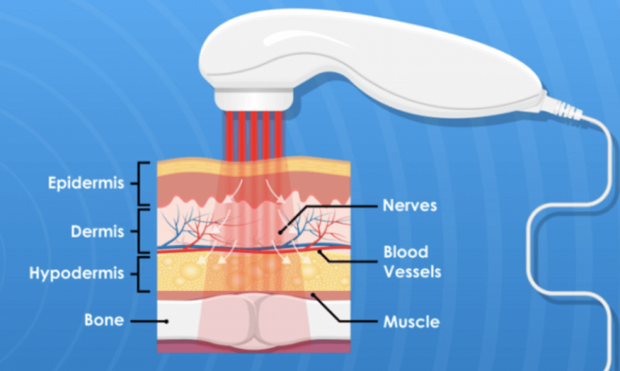
Cooling Techniques
Cooling reduces epidermal damage and pain.
Types:
Contact cooling (sapphire tip or chilled gel)
Cryogen spray cooling
Cold air cooling devices

Slide 132
Local Anesthesia
Used when procedures are more painful.
Methods:
Infiltration anesthesia with Lidocaine
Nerve blocks (e.g. mental nerve block)

Slide 133

Indications
Ablative laser resurfacing
Treatment of large vascular lesions
Tattoo removal

Slide 134
Regional or Field Blocks
Helpful for procedures in specific anatomical regions:
Infraorbital nerve block – upper lip, cheek
Mental nerve block – lower lip, chin
Reduces need for multiple injections.

Slide 135
Systemic Analgesia / Sedation
Used for extensive or highly painful procedures.
Options:
Oral analgesics: Paracetamol, Ibuprofen
Anxiolytics: Diazepam
In selected cases: conscious sedation

Slide 136
Post-procedure Pain Control
Cold compresses or ice packs
Mild analgesics (e.g., Paracetamol)
Topical soothing agents (aloe vera, emollients)

Slide 137
Factors Affecting Pain
Laser wavelength
Pulse duration
Skin thickness and site (face < axilla < genital area)
Patient pain tolerance
Previous laser sessions

Slide 138
Questions
What factors influence pain during dermatologic laser procedures?
What is the role of topical anesthetics such as EMLA cream in laser treatments?
Name two cooling methods used to reduce pain during laser therapy.
When is local anesthesia with Lidocaine indicated in dermatologic laser procedures?
What systemic medications can be used for pain control after laser treatment?

Slide 139

Dermatological Disorders
Dermatological disorders are diseases or conditions that
affect the skin, hair, nails, and associated glands.

Slide 140

Common Causes
Infections – bacteria, fungi, viruses, parasites
Allergies – reactions to chemicals, cosmetics, food, or drugs
Genetic factors
Autoimmune diseases
Environmental factors – sunlight, pollution, irritants

Slide 141
Common Types
Acne
Caused by blocked sebaceous glands
Leads to pimples, blackheads, whiteheads
Eczema (Dermatitis)
Skin inflammation causing itching, redness, and dryness

Slide 142

Common Types
Acne
Caused by blocked sebaceous glands
Leads to pimples, blackheads, whiteheads
Eczema (Dermatitis)
Skin inflammation causing itching, redness, and dryness

Slide 143
Common Types
Acne
Caused by blocked sebaceous glands
Leads to pimples, blackheads, whiteheads
Eczema (Dermatitis)
Skin inflammation causing itching, redness, and dryness

Slide 144
Psoriasis
Autoimmune disorder causing thick, scaly skin patches
Fungal infections
Examples: ringworm, athlete’s foot
Skin cancer
Caused mainly by excessive UV exposure

Slide 145
Diagnosis Methods
Visual examination
Dermoscopy
Skin biopsy
Laboratory tests

Slide 146
Treatment
Topical creams and ointments
Antibiotics or antifungal drugs
Phototherapy
Laser therapy
Lifestyle and hygiene management

Slide 147
Questions
What is meant by dermatological disorder?
What are the main functions of the skin?
What is acne?
What causes eczema?
What is psoriasis?
What are the symptoms of fungal skin infection?
What is dermatitis?

Slide 148
Lasers in Cardiovascular Diagnostics
Lasers are used in diagnosing and studying heart
and blood vessel diseases because they provide high precision and non-invasive measurements.

Slide 149
Principle
Laser light interacts with blood cells, tissues, and blood flow, allowing measurement of circulation and vessel condition

Slide 150
Major Diagnostic Applications
Laser Doppler Flowmetry
Measures blood flow in microcirculation
Based on Doppler shift when laser light hits moving red blood cells
Used to assess:
Tissue perfusion
Peripheral vascular diseases

Slide 151
Optical Coherence Tomography (OCT)
Uses near-infrared laser light
Produces high-resolution images of coronary arteries
Helps detect:
Plaque buildup
Vessel wall structure

Slide 152
Laser Angiography
Visualizes blood vessels using laser illumination
Helps detect blockages and abnormalities

Slide 153
Laser Speckle Imaging
Measures blood flow distribution in tissues
Advantages
Non-invasive or minimally invasive
High resolution imaging
Real-time monitoring of blood flow
High sensitivity

Slide 154
Clinical Uses
Diagnosis of coronary artery disease
Monitoring microcirculation
Evaluating vascular disorders
Studying blood flow dynamics

Slide 155
Questions
What is the role of lasers in cardiovascular diagnostics?
What is laser Doppler flowmetry used to measure?
How are lasers used to study blood flow in arteries?
What is the principle of laser-based blood flow measurement?
What are the advantages of using lasers in cardiovascular diagnostics?

Slide 156

Lasers in Cardiovascular Therapy
Laser technology is used in cardiovascular medicine mainly to treat blocked or narrowed blood vessels and certain heart rhythm problems

Slide 157

Laser Angioplasty (Laser-Assisted Angioplasty)
A catheter with a laser fiber is inserted into the blocked artery.
The laser emits short bursts of light.
The plaque is vaporized into tiny particles.
Blood flow improves, often followed by balloon angioplasty or stent placement.

Slide 158

Types of lasers used:
Excimer laser
Holmium:YAG laser
Advantages:
Can treat hard or calcified plaques
Useful in chronic total occlusions
Minimally invasive

Slide 159

Laser Atherectomy
Laser atherectomy removes plaque from arterial walls.
Uses:
Peripheral artery disease
Coronary artery disease
In-stent restenosis (re-narrowing after stent)

Slide 160
Mechanism
Laser energy breaks plaque through:
Photochemical
Photothermal
Photomechanical effects

Slide 161

Trans myocardial Laser Revascularization (TMR)
Used for severe coronary artery disease when bypass surgery is not possible.
Laser creates small channels in the heart muscle (myocardium).
These channels allow blood from the heart chamber to reach oxygen-deprived tissue.

Slide 162
Benefits
Reduces angina (chest pain)
Improves myocardial perfusion

Slide 163
Laser Treatment for Arrhythmias
Laser energy can sometimes be used for cardiac tissue ablation.
Destroy abnormal electrical pathways causing arrhythmias.

Slide 164
Advantages of Laser Therapy
High precision
Minimally invasive
Reduced damage to surrounding tissue
Can treat complex arterial blockages

Slide 165
Questions
Discuss in detail the laser treatment methods used for eye tissues and eye diseases, including the advantages, working principles, and examples of ophthalmic laser procedures.
Explain how lasers are used in handling pain, treating dermatological disorders, and discuss the role of lasers in cardiovascular diagnostics and cardiovascular therapy.
3 Explain the construction and working principle of the following lasers with suitable diagrams:
(a) Solid state laser
(b) Atomic laser

Slide 166

Lasers treatment for benign prostatic hyperplasia
Laser therapy is a well-established minimally invasive option for treating Benign Prostatic Hyperplasia (BPH). It uses focused laser energy to remove or shrink excess prostate tissue that is blocking urine flow.

Slide 167
Laser therapy Needed
laser therapy uses thermal energy to:
Vaporize tissue
Coagulate blood vessels
Enucleate (peel out) adenoma

Slide 168

Common Types of Laser Treatments
Photoselective Vaporization of the Prostate (PVP)
Often called Green Light laser
Vaporizes prostate tissue using high-energy laser
Good for small moderate prostate enlargement
Less bleeding suitable for patients on blood thinners

Slide 169
Laser type: Potassium-titanyl-phosphate (KTP) / Lithium triborate
Wavelength: 532 nm (green light)
Absorption: Strongly absorbed by hemoglobin

Slide 170
Mechanism
Converts laser energy - heat -instant vaporization of tissue
Simultaneously seals blood vessels -excellent hemostasis

Slide 171

Holmium Laser Enucleation of the Prostate (HoLEP)
Uses a holmium laser to cut and remove large portions of prostate tissue
Works for all prostate sizes, especially large glands
Tissue is removed and can be tested (unlike vaporization)

Slide 172
Laser type: Holmium:YAG
Wavelength: 2140 nm
Absorption: Water-rich tissue

Slide 173
Holmium Laser Ablation (HoLAP)
Similar to PVP but uses holmium laser
Less commonly used today
Tissue is pushed into bladder -removed
Mechanism:
Pulsed laser- precise cutting + coagulation

Slide 174

Thulium Laser Procedures
Includes ThuLEP (enucleation) and vaporization techniques
Precise cutting with good hemostasis

Slide 175
Mechanism
Wavelength: ~2010 nm
Continuous-wave laser.
Smooth, continuous cutting
Better visualization vs pulsed lasers
Combines precision + hemostasis

Slide 176
Advantages
Minimally invasive (no large incisions)
Short hospital stay (often same-day discharge)
Less bleeding than traditional surgery
Faster recovery
Can be used in patients on anticoagulants

Slide 177
Side Effects
Burning sensation during urination (temporary)
Frequent urination initially
Retrograde ejaculation (common)
Rare: urinary dysfunction

Slide 178
Compared to Traditional Surgery (TURP)
Similar effectiveness
Lower bleeding risk
Shorter catheter time and hospital stay
HoLEP is often considered a modern alternative standard

Slide 179
Questions
What is the role of laser therapy in Benign Prostatic Hyperplasia?
Name two types of laser procedures used for BPH.
Which laser technique is most suitable for large prostate glands?
What is a common complication following laser prostate surgery?
How does laser therapy differ from TURP in terms of bleeding risk?

Slide 180

Lasers treatment for bladder neck incision
Laser treatment for bladder neck incision MIS procedure used to treat bladder neck obstruction
a condition where the opening of the bladder into the urethra doesn’t relax properly, making urination difficult.

Slide 181

Procedure
a laser (like Holmium or Green Light)
is used to make small cuts in the bladder
neck to widen the opening.

Slide 182

Working
A thin scope (cystoscope) is inserted
through the urethra (no external cuts).
1–2 small incisions at the bladder neck.
This reduces resistance and improves urine flow.

Slide 183
Effectiveness
Symptom improvement: 80–90%
Urine flow rate significantly increases

Slide 184
Durability
Long-term success is good, but:
~10–20% may need repeat procedure

Slide 185
Activity restrictions
No heavy lifting for 2 weeks
Avoid straining
Hydrate well

Slide 186
Questions
What is laser bladder neck incision used to treat?
How does the laser procedure improve urine flow?
What are the main benefits of laser BNI compared to traditional surgery?
What are the possible side effects or risks of the procedure?
How long does recovery usually take after laser bladder neck incision?

Slide 187

Laser treatment for bladder tumor
This is usually done during a procedure called cystoscopy (camera inserted through the urethra into the bladder).

Slide 188

Working
A thin scope is passed into the bladder.
A laser fiber is used to:
Destroy (ablate) the tumor
Or cut it away (enucleate/resect)

Slide 189

Laser types
Holmium laser (Ho: YAG)
Thulium laser .
Small, superficial bladder tumors
Patients who may not tolerate more invasive surgery

Slide 190
Advantages
Less bleeding
Precise targeting
Can often be done as a minimally invasive procedure

Slide 191

Laser treatment for upper urinary tract tumors
involves tumors in:
Ureter (tube from kidney to bladder)
Renal pelvis (inside the kidney)

Slide 192
Working
scope (ureter scope) is passed through the urinary tract up to the tumor
A laser fiber is used to:
Ablate the tumor
Preserve surrounding tissue

Slide 193
Uses
Small, low-grade tumors
Patients where kidney preservation is important (e.g., one kidney)

Slide 194
Advantages
Kidney-sparing (avoids removing the kidney)
Minimally invasive
Short recovery time

Slide 195
Questions
What are the indications for laser treatment in bladder tumors?
Which lasers are commonly used in urological tumor management?
What is one key advantage of laser over TURBT?
When is laser therapy indicated for upper urinary tract tumors?
What is the main limitation of laser treatment in upper tract tumors?

Slide 196

Lasers in Gynecology
It produces a coherent, monochromatic, and highly focused beam of light used for precise surgical applications like cutting, coagulation, and vaporization.

Slide 197
Principle
Laser energy is absorbed by specific tissue chromophores:
Water
Hemoglobin
Melanin
Energy - converted into heat (photothermal effect)

Slide 198
Effects on tissue
Vaporization - destroys tissue (at >100°C)
Coagulation -seals blood vessels (60–100°C)
Carbonization - tissue charring
Cutting - precise incision with minimal spread

Slide 199
Types of Lasers and Their Characteristics
CO₂ Laser
Wavelength: 10,600 nm
Absorbed by water → superficial penetration (0.1–0.2 mm)
Most commonly used in gynecology
Uses:
genital , vaginal lesions

Slide 200
Nd: YAG Laser
Deeper penetration (4–6 mm)
Strong coagulation effect
Uses:
Hemostasis
Endometriosis (less common)

Slide 201
Argon Laser
Absorbed by hemoglobin
Good for vascular lesions
Diode Laser
Compact, portable
Used in minor gynecological procedures

Slide 202
Modes of Laser Application
Continuous mode → cutting and vaporization
Pulsed mode → controlled tissue damage
Contact mode → fiber touches tissue
Non-contact mode → beam delivered at a distance

Slide 203

Lasers in Laparoscopy
Lasers deliver focused light energy - converted to heat - causes:
Vaporization (cutting) (>100°C)
Coagulation (hemostasis) (60–100°C)

Slide 204

Types of Lasers Used
CO₂ Laser
Wavelength: 10,600 nm
Highly absorbed by water
Superficial penetration (~0.1 mm
Precise cutting
Endometriosis ablation

Slide 205
Nd: YAG Laser
Wavelength: 1064 nm
Deeper penetration (5–10 mm)
Strong coagulation
Used for:
Hemostasis
Tumor

Slide 206
Argon Laser
Absorbed by hemoglobin
vascular lesions
Delivery Systems
Fiberoptic cables through laparoscope
Handpieces or articulated arms (CO₂)
Contact vs non-contact modes

Slide 207
LASERS IN LARYNGEAL SURGERY
CO₂ Laser is Ideal
Strong absorption by water → precise superficial action
Minimal penetration → protects deeper vocal structures
Can be focused to <0.2 mm spot size

Slide 208
Equipment Setup
Operating microscope
Micromanipulator for beam control
Laser-safe endotracheal tube (wrapped with foil or saline-filled cuff)

Slide 209
Modes of Laser Use
Continuous mode - cutting
Pulsed mode - reduces thermal damage
ultrapulse -high peak power, minimal spread

Slide 210
Clinical Indications
Benign Lesions
Vocal nodules
Cysts
Premalignant
Malignant
Early glottic carcinoma (T1, T2)
Airway Conditions
Subglottic stenosis
Laryngeal webs

Slide 211
Advantages
Excellent visibility (bloodless field)
Preservation of normal tissue
Short hospital stay
Better voice outcomes

Slide 212
Questions
What type of laser is most commonly used in laparoscopic surgery?
Why is the CO₂ laser preferred in laryngeal procedures?
What is the most serious complication associated with laser use in laryngeal surgery?
List two advantages of using lasers in laparoscopy.

Slide 213

Lasers in Otology
emits a focused, monochromatic beam of light that can:
Cut tissue
Vaporize tissue
Coagulate blood vessels

Slide 214

Common Types of Lasers Used in Otology
CO₂ Laser
Most commonly used in ear surgery
Highly absorbed by water - precise cutting with minimal penetration
Delivered via microscope or micromanipulator.

Slide 215
Uses:
Stapedotomy
Tympanoplasty
Cholesteatoma removal

Slide 216
KTP Laser (Potassium Titanyl Phosphate)
Green light (532 nm)
Highly absorbed by hemoglobin- excellent for vascular lesions
Uses:
Glomus tumors
Vascular middle ear lesions

Slide 217
Argon Laser
Blue-green spectrum
Good for coagulation
Uses:
Stapes surgery
Ossicular procedures

Slide 218
Diode Laser
Compact and portable
Delivered via fiber-optic cable
Uses:
Soft tissue procedures
Office-based ENT surgeries

Slide 219
YAG Laser
Strong absorption in water
Precise bone ablation
Uses:
Experimental inner ear and bone work

Slide 220
Applications in Otology
Stapes Surgery (Otosclerosis)
Laser creates a small fenestra in the stapes footplate
Reduces mechanical trauma vs drill
Advantages:
Less inner ear damage
Reduced risk of sensorineural hearing loss

Slide 221
Cholesteatoma Surgery
Helps remove residual disease in difficult areas
Vaporizes epithelial tissue precisely

Slide 222
Tympanoplasty
Margin freshening
Graft placement assistance

Slide 223
Myringotomy
Laser creates tympanic membrane incision
Often used in children
Advantage:
No bleeding
No mechanical trauma

Slide 224
Tumor Removal
Especially vascular tumors
Laser helps coagulate vessels before removal

Slide 225
Questions
Which laser is most commonly used in otology?
Name one use of laser in stapes surgery.
Which laser is preferred for vascular middle ear lesions?
Mention one advantage of lasers in ear surgery.

Slide 226

Lasers in Neurology
Lasers play an important and growing role in neurology, mainly in diagnosis, treatment, and research.

Slide 227

Therapeutic Uses
Laser Surgery (Neurosurgery)
High-precision lasers are used to remove brain tumors or abnormal tissue.

Slide 228

Advantages
Minimal damage to surrounding brain tissue
Smaller incisions
Faster recovery

Slide 229
Pain Management
Low-level lasers (also called cold lasers) are used in:
Neuropathic pain
Peripheral nerve injuries
They work by:
Reducing inflammation
Stimulating tissue repair
Improving blood flow

Slide 230
Treatment of Epilepsy
Laser ablation can precisely destroy seizure-causing brain areas.
Often used when medications fail.

Slide 231
Diagnostic Applications
Optical coherence tomography (OCT) – for retina and optic nerve (important in neurological diseases like multiple sclerosis)
Laser Doppler flowmetry – measures blood flow in the brain

Slide 232
Functional Brain Mapping
Laser-based tools help identify active brain regions during surgery.
Useful in avoiding critical areas (speech, movement).

Slide 233
Research Applications
Optogenetics
A cutting-edge technique where lasers control neurons that have been genetically modified to respond to light.
Used to study:
Brain circuits
Behavior
Neurological diseases

Slide 234
Neural Stimulation
Laser pulses can stimulate neurons with high precision.
Helps understand how the brain processes information.

Slide 235
Advantages of Lasers in Neurology
Extremely precise
Minimally invasive
Reduced bleeding and infection risk
Faster patient recovery

Slide 236
Questions
What is the principle behind laser interstitial thermal therapy (LITT)?
Name one neurological condition treated using laser ablation.
What is the role of lasers in optical coherence tomography (OCT)?
Define optogenetics in the context of neuroscience.
Mention one advantage of using lasers in neurosurgery.

Slide 237
Common Laser Wavelengths
Diode lasers (LITT, therapy): ~ 800 – 980 nm (near-infrared)
Nd:YAG laser: 1064 nm
CO₂ laser: 10,600 nm (far-infrared)
Helium–Neon (He-Ne) laser: 632.8 nm (red light)
Optogenetics lasers: ~470 nm (blue light) or ~530 nm (green light)

Slide 238

Mechanism of bone and cartilage reparation.
The mechanism is based on how laser light interacts with biological tissues to stimulate healing rather than just cutting or ablating.

Slide 239

Photobiomodulation
low-level laser therapy (LLLT).
Laser light (usually red or near-infrared) penetrates tissue.
It is absorbed by mitochondrial This increases:
ATP production (cellular energy)
Oxygen consumption
Cellular metabolism

Slide 240
Stimulates osteoblasts (bone-forming cells)
Activates chondrocytes (cartilage cells)
Enhances tissue regeneration

Slide 241

Cellular Proliferation & Differentiation
Laser exposure promotes:
Stem cell differentiation into:
Bone cells (osteogenesis)
Cartilage cells (chondrogenesis)

Slide 242
DNA/RNA synthesis
Protein production (collagen, matrix proteins)
Important for rebuilding extracellular matrix.

Slide 243
Growth Factor Activation
Laser irradiation stimulates release of:
Bone Morphogenetic Proteins (BMPs)
Transforming Growth Factor-beta (TGF-β)
Vascular Endothelial Growth Factor (VEGF)

Slide 244
Effects:
Faster bone healing
Improved cartilage repair
Enhanced angiogenesis (new blood vessel formation)

Slide 245
Anti-inflammatory Effects
Laser reduces inflammation by:
Decreasing pro-inflammatory cytokines
Increasing anti-inflammatory mediators
Leads to:
Reduced swelling
Pain relief
Better healing environment

Slide 246
Enhanced Blood Circulation
Laser causes:
Vasodilation
Improved microcirculation
Outcome:
More oxygen and nutrients delivered
Faster removal of waste products

Slide 247
Collagen Synthesis & Matrix Remodeling
Stimulates fibroblasts – increased collagen production
Improves organization of collagen fibers
Critical for:
Cartilage elasticity
Bone strength

Slide 248
Laser-Induced Thermal Effects (High-Power Lasers)
In surgical settings:
Controlled heating can:
Seal tissues
Weld cartilage (laser cartilage reshaping)
Assist in precise bone cutting
Excess heat can damage tissue, so parameters must be carefully controlled.

Slide 249

Bone vs Cartilage Repair

Slide 250
Questions
What is photobiomodulation in laser therapy?
Which cells are stimulated during bone repair by lasers?
Name any one laser used in cartilage repair.
What is the role of ATP in laser-induced healing?
Which growth factor is activated during laser therapy?
How does laser therapy reduce inflammation?

