Slide 1
Overview
History, Evolution Of HDL
Typical HDL- based Design Flow
Comparison with Software Programming Languages
Verilog
Register Transfer and Micro Operation
Register Transfer Language
Bus and Memory Transfer
Shift Register
Micro operations (Arithmetic, logic, shift)
Addition, Subtraction
Multiplication Algorithm
Booth Multiplication
CSE 211, Computer Organization and Architecture

Slide 2
History of HDL (Hardware Description Languages)
In the early days, digital circuits were designed using manual schematics and logic gates.
Engineers drew circuits using AND, OR, NOT gates on paper.
As systems became complex (microprocessors, controllers, FPGA-Field Programmable Gate Array designs), manual design became difficult and error-prone.
Designers needed a faster and more reliable way to describe hardware systems.

Slide 3
Evolution of Hardware Description Languages (HDLs)
To simplify digital system design, Hardware Description Languages (HDLs) were introduced.
HDLs allow engineers to describe hardware behavior using code rather than drawing circuits.
Designers can model systems at different levels such as behavioral, dataflow, and structural level.
The two most widely used HDLs are:
VHDL (Very High-Speed Integrated Circuit Hardware Description Language)
Verilog

Slide 4
Typical HDL-Based Design Flow
HDL design follows a systematic process:
Design → Simulation → Synthesis → Verification
Design
- Write HDL code describing the circuit
Simulation
- Test the design using a simulator
Synthesis
- Convert HDL code into hardware gates
Verification
- Ensure the circuit produces correct outputs

Slide 5
Data types in HDL
wire → Most commonly used connection
tri → Tri-state wire (can be high impedance Z)
wand → Wired-AND logic
wor → Wired-OR logic
Common Variable Types:
reg → Stores value (used in procedural blocks)
integer → Whole numbers
real → Decimal values
time → Simulation time values
Special Values in HDL
0 → Logic 0
1 → Logic 1
X → Unknown
Z → High impedance

Slide 6
HDL Design Flow Using EDA Playground
Steps performed in the simulator:
Write Verilog Design
- Describe the hardware circuit
Create Testbench
- Apply input signals for testing
Run Simulation
- Execute the design using simulator
View Waveform
- Observe signal behavior using EPWave
Verify Output
- Compare results with expected output

Slide 7
Verilog
Verilog is a Hardware Description Language (HDL) used to design and model digital circuits such as adders, multiplexers, registers, processors, etc.
Basic Structure of Verilog Code
module module_name (input_ports, output_ports);
// Declare inputs and outputs
input A, B;
output Y;
// Logic
assign Y = A & B;
endmodule

Slide 8
Link for simulator
https://www.edaplayground.com/
Sign with google account
An EDA ( Electronic Design Automation) simulator is a tool used to:
Design electronic circuits
Simulate digital systems (like logic gates, HDL designs)
Test circuits before actual hardware implementation

Slide 9
Left Window – Testbench (testbench.sv)
This is where you write the testbench code.
A testbench is used to provide inputs and check outputs.
It simulates how the circuit behaves.
Right Window – Design (design.sv)
This is where you write the actual Verilog circuit design.
Example (AND Gate):
Run the Simulation
Steps:
Write design code on the right side.
Write testbench code on the left side.
Click Run (top blue button).
Output will appear in the Log window below.

Slide 10
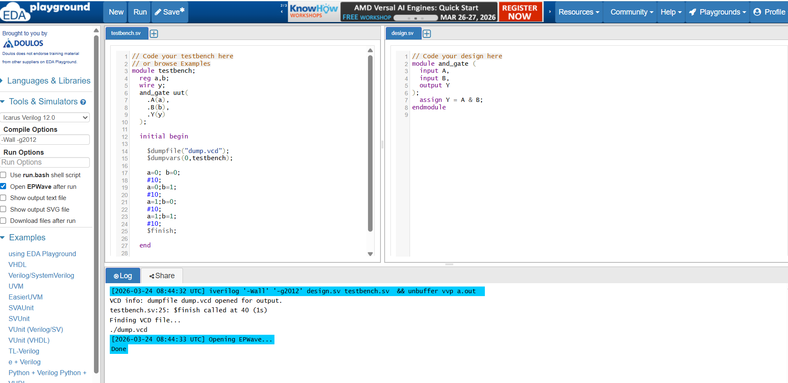




Slide 11
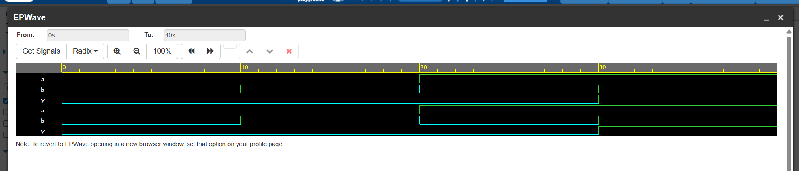
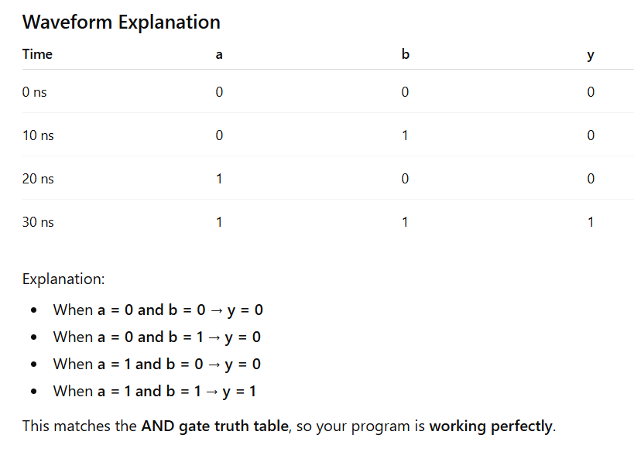
Duplicate signals appear because both testbench and module signals are displayed.
$dumpvars(1, testbench); only test bench shows

Slide 12
Verilog part (Right side of EDA)
Name of module
module and_gate ( // module is keyword in Verilog means start of hardware block input A, // inside the brackets define inputs and outputs input B, // A and B as in output Y // Y as output ); assign Y = A & B; // Continuously assign the output based on inputs
// assign AND of to inputs A and B to output Y. endmodule

Slide 13
Testbench part(left sideof EDA)
module testbench ; // testbench module
reg a, b; // reg is a data type used to store a value in
Verilog. (for assign input values)
wire y; // wire does not store value, it transfer the
value.( Y is not assign, its drive from and_gate
// Instantiate AND gate (connect design with testbench)
and_gate uut ( // uut = Unit Under Test (instance name)
.A(a), // connect testbench a → design input A
.B(b), // connect testbench b → design input B
.Y(y) // connect design output Y → testbench y
);
initial begin // start simulation block
$dumpfile("dump.vcd"); // create file to store signal
changes
$dumpvars(0, testbench); // store all variables of
testbench
// apply test cases
a = 0; b = 0; // both inputs 0
#10; // wait for 10 time units
a = 0; b = 1; // input combination 0,1
#10;
a = 1; b = 0; // input combination 1,0
#10;
a = 1; b = 1; // input combination 1,1
#10;
$finish; // stop simulation
end
endmodule // end of testbench module

Slide 14
module testbench;
reg a,b;
wire y;
and_gate uut(
.A(a),
.B(b),
.Y(y)
);
initial begin
$dumpfile("dump.vcd");
$dumpvars(0,testbench);
a=0; b=0;
#10;
a=0;b=1;
#10;
a=1;b=0;
#10;
a=1;b=1;
#10;
$finish;
end
endmodule
module and_gate (
input A,
input B,
output Y
);
assign Y = A & B;
endmodule

Slide 15
1. $dumpfile("dump.vcd");
Meaning:
Creates a file named dump.vcd to store simulation data
.vcd = Value Change Dump file
It records how signals change over time
2. $dumpvars(0, testbench);
Meaning:
Tells simulator to store all variable changes in the testbench
Breakdown:
0 → dump all levels (full hierarchy)
testbench → module name
✔ So:
Record all signals (a, b, y) during simulation
3. design.sv → the machine (actual circuit)
testbench.sv → the tester (checks if machine works correctly)
.sv=systemverilog

Slide 16
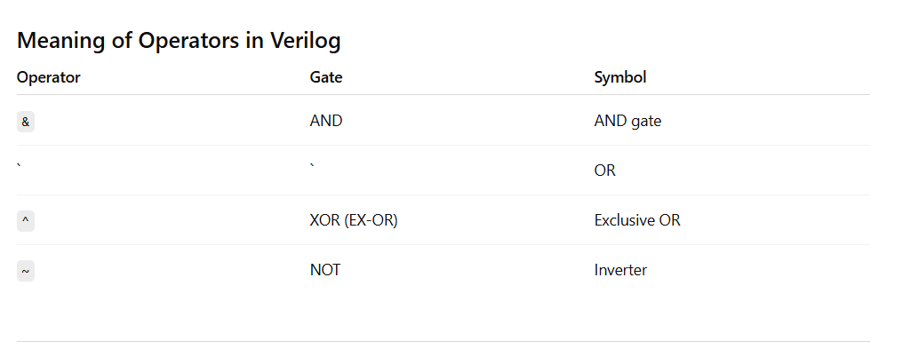

Slide 17
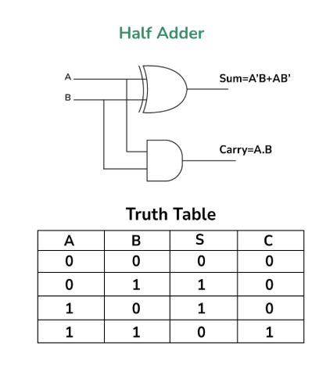

Slide 18
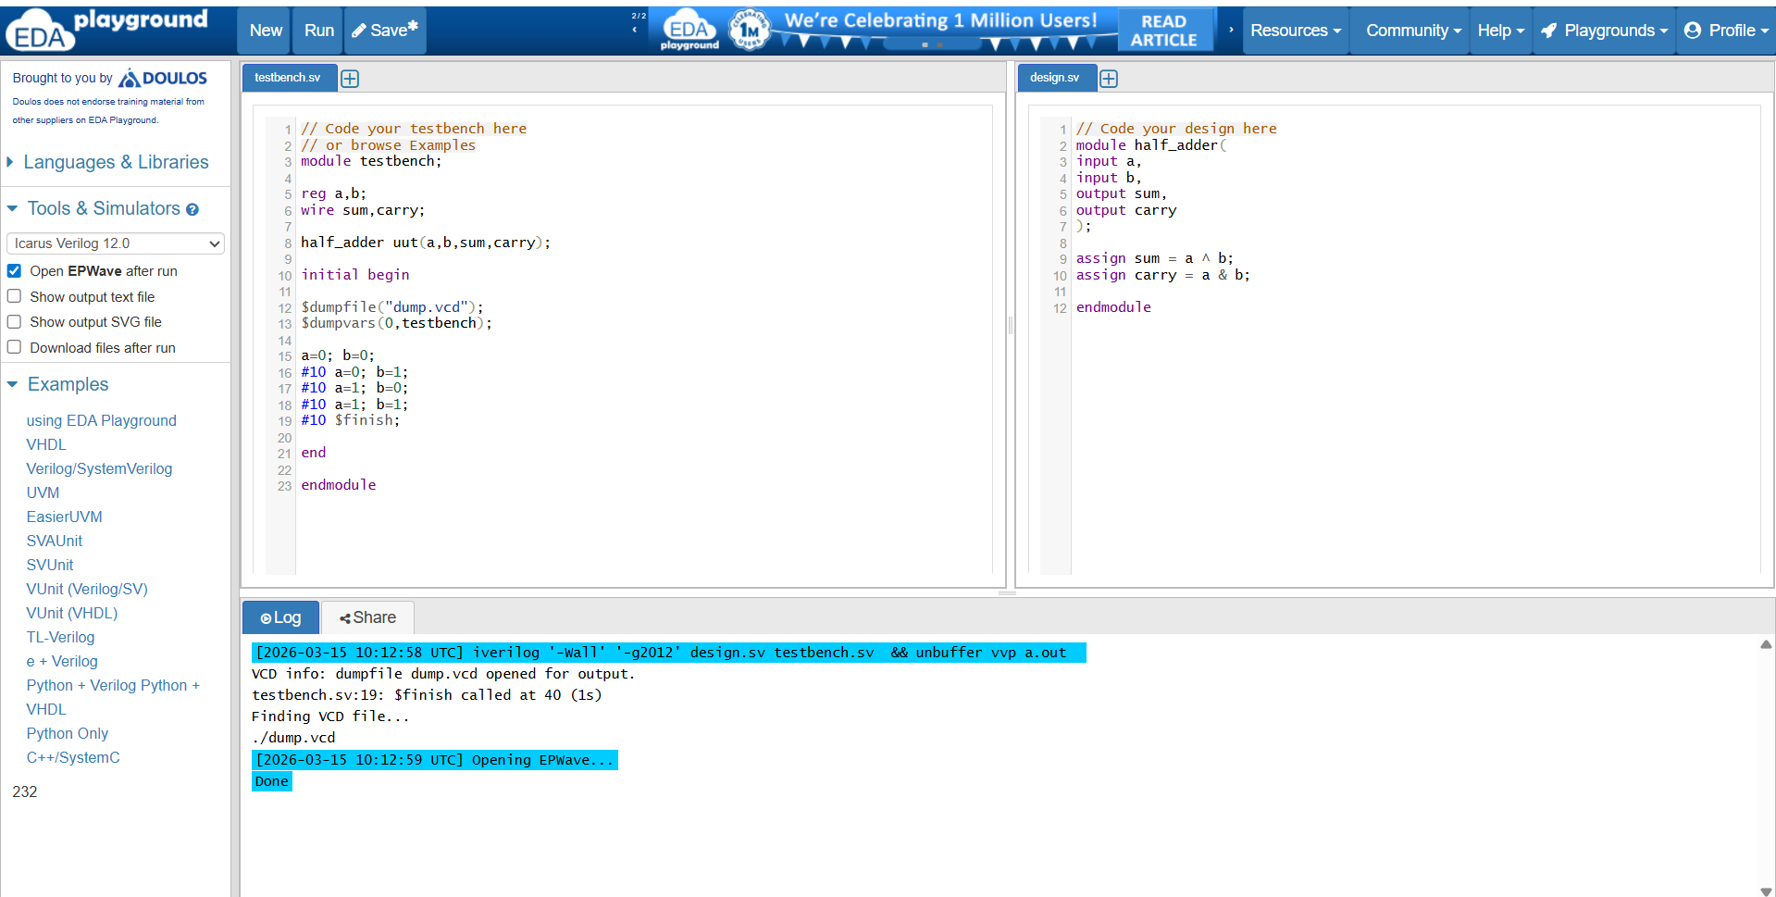
Half Adder
Verilog code

Slide 19
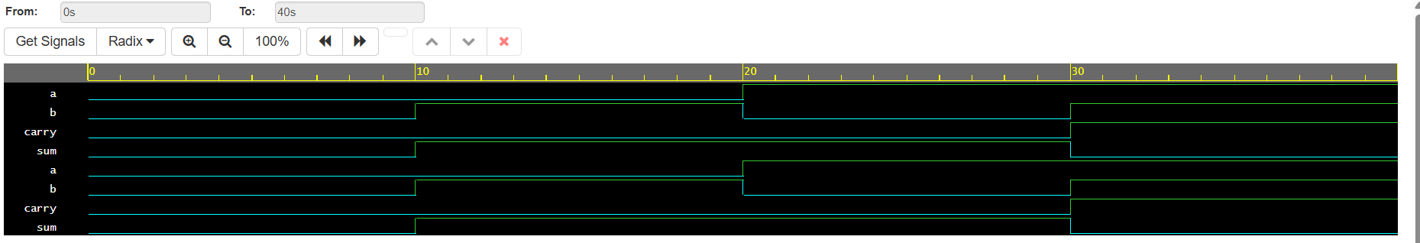

Slide 20
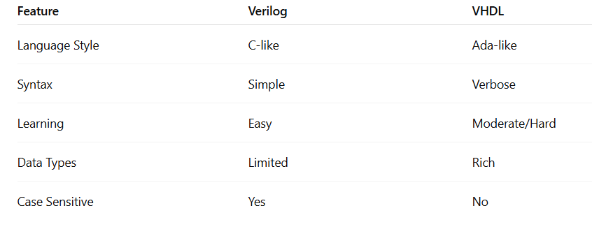
Difference between Verilog and VHDL
Note:
Use Verilog → if you want easy and fast coding
Use VHDL → if you need strict, reliable, large design

Slide 21
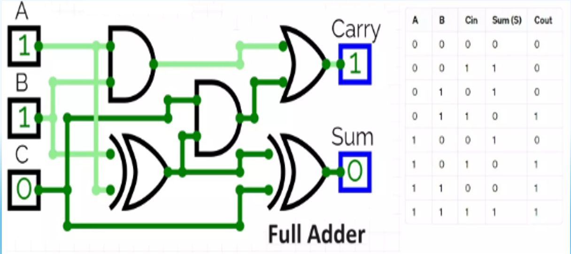

Slide 22
Code for full adder
initial begin
$dumpfile("dump.vcd");
$dumpvars(0,full_adder_tb);
// Apply test cases A=0; B=0; Cin=0; #10; A=0; B=0; Cin=1; #10; A=0; B=1; Cin=0; #10; A=0; B=1; Cin=1; #10; A=1; B=0; Cin=0; #10; A=1; B=0; Cin=1; #10; A=1; B=1; Cin=0; #10; A=1; B=1; Cin=1; #10; end endmodule
//in testbench box
module full_adder_tb; reg A, B, Cin; wire Sum, Cout; full_adder uut (A, B,Cin,Sum,Cout );
// in design box
module full_adder(
input A,
input B,
input Cin,
output Sum,
output Cout
);
// Sum calculation
assign Sum = A ^ B ^ Cin;
// Carry calculation
assign Cout = (A & B) | (B & Cin) | (A & Cin);
endmodule

Slide 23
Comparison: HDL vs Software Programming
Feature | Software Programming | HDL
Purpose | Develop software programs | Design hardware circuits
Execution | Sequential | Parallel
Examples | C, Java, Python | Verilog, VHDL
Output | Software application | Digital hardware

Slide 24
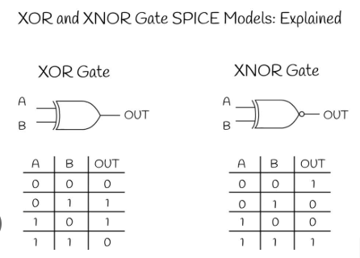
Circuit Verse examples

Slide 25
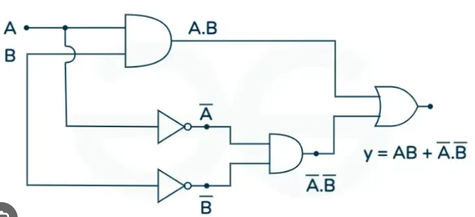

Slide 26
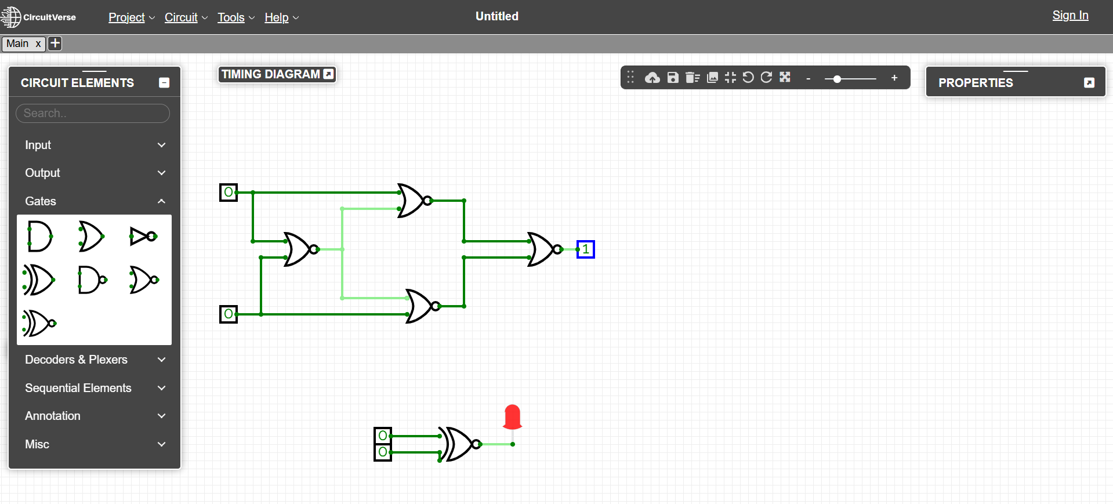
X-NOR gate

Slide 27
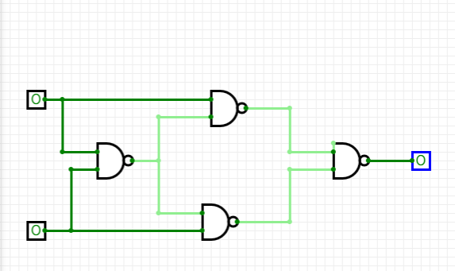
XOR gate

Slide 28
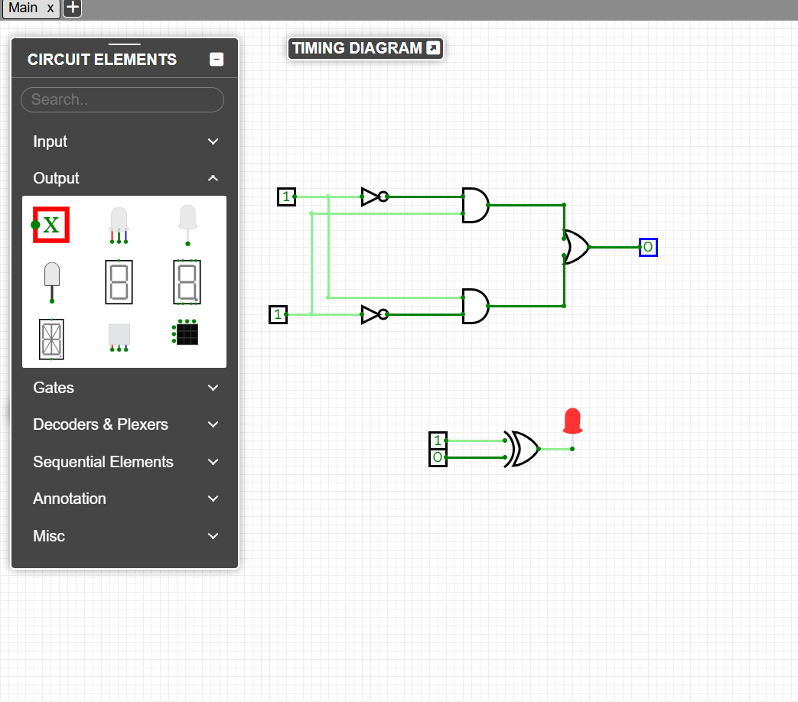
XOR gate

Slide 29
